Slide 1
PEA – 516
Lecture – 17
Relation between Simple and Compound Interest

Slide 2
CONTENT-:
Relation between Simple and Compound Interest
Problems on Depreciation

Slide 3
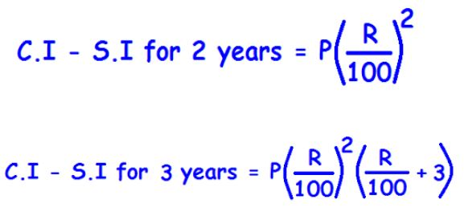

Slide 4
Question: The difference between C.I and S.I at some rate for Rs. 5000 for 2 years is Rs. 72. what is the rate of interest per annum?
[A] 6% pa
[B] 10% pa
[C] 12% pa
[D] 15% pa

Slide 5
Question: The difference between the compound interest and simple interest on a certain sum at 12% per annum for 2 years is Rs.126.72. Find the sum.
[A] Rs.8000
[B] Rs.8800
[C] Rs.10200
[D] Rs.12400

Slide 6
Question: If the difference between S.I and C.I at 4% P.A for 2 years is 20 Rs. What will be the value of principle amount?
[A] Rs.50000
[B] Rs.12000
[C] Rs.12500
[D] Rs.25000

Slide 7
Question: What will be the difference between the S.I and C.I. On Rs. 600 for one year at 10% P.A, if compounded half yearly.
[A] Rs.1.5
[B] Rs.15
[C] Rs.3.5
[D] Rs.35

Slide 8
Que - There is 60% increase in an amount in 6 years at simple interest. What will be the compound interest of Rs. 12,000 after 3 years at the same rate?
a) Rs. 2160
b) Rs. 3120
c) Rs. 3972
d) Rs. 6240

Slide 9
Question: If the S.I of certain money for 3 years is Rs. 225 & C.I on same money, same rate for 2 years is Rs. 153. then what was the principal amount?
[A] Rs.875
[B] Rs.1875
[C] Rs.785
[D] Rs.1785

Slide 10
Que - The compound interest on a sum of money for 2 years is rs.832 and the simple interest on the same sum for the same period is rs.800 .the difference between the compound interest and simple interest for 3 years is
a) 48
b) 66.56
c) 98.56
d) None

Slide 11
Que - The value of a car depreciates at the rate of 12% p.a. every year. If the present value of the car is Rs.154880. its value two years ago was ?
a) Rs.360000
b) Rs.240000
c) Rs.200000
d) Rs.300000

Slide 12
Que -. The value of the laptop depreciates at the rate of 30 % per annum. The present value of the laptop if Rs. 40000. What will be the worth of laptop two years from now?
A. Rs. 28000 B. Rs 16000 C. Rs. 24400 D. Rs. 19600

Slide 13
Que -: A car was bought at Rs. 12000. If the value of the car decreases by 1 % every year, what will be the value of the car after 3 months?
A. Rs. 11643 B. Rs. 11640 C. Rs. 11543 D. Rs. 11580

Slide 14


